Slide 1

Strategy and Structure of International Business
UNIT 4

Slide 2

Strategy and Structure of International Business
The strategy and structure of international business explain how multinational companies plan their global operations and organize their activities across different countries. International business strategies help firms expand into new markets, increase profits, and gain competitive advantage.
Example: Companies like Apple and Samsung design global strategies to sell their products in multiple countries.

Slide 3
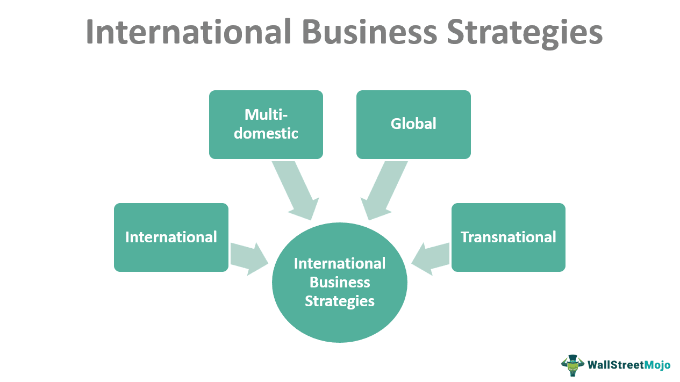
Strategy of International Business
The strategy of international business refers to long-term plans adopted by companies to compete successfully in international markets. It involves decisions about production, marketing, expansion, and resource allocation.
Example: Apple designs products in the United States but manufactures them in countries with lower production costs.

Slide 4

Objectives of International Business Strategy
Expand into Global Markets One of the main objectives of international business strategy is to expand a company’s operations into foreign markets. This helps businesses reach new customers and increase their global presence. Example: Companies like Apple and Samsung sell their products in many countries to increase their customer base.
Increase Global Market Share International strategies help companies compete in international markets and gain a larger share of the global market. Example: Coca-Cola sells beverages worldwide to maintain its strong global market position.
Achieve Competitive Advantage Companies use international strategies to gain advantages over competitors by offering better products, lower prices, or innovative services in global markets. Example: Toyota competes globally by producing reliable and fuel-efficient vehicles.
Reduce Production and Operating Costs Companies may shift production to countries where labor and resources are cheaper in order to reduce manufacturing costs and increase profitability. Example: Many technology companies manufacture products in countries with lower labor costs.
Access Global Resources and Technology Expanding internationally allows companies to access resources, skilled labor, advanced technology, and raw materials available in different countries. Example: Automobile companies establish production plants in countries with strong manufacturing capabilities.
Increase Profitability and Business Growth International business strategy helps companies grow faster by entering new markets and increasing sales worldwide. Example: Fast-food companies like McDonald’s generate a large portion of their revenue from international markets.

Slide 5
Importance of International Business Strate
Helps Companies Compete in Global Markets International business strategy enables companies to compete effectively with other businesses operating in global markets. A well-planned strategy helps organizations understand international competition and develop methods to succeed in different countries. Example: Samsung competes with other smartphone companies in international markets by offering innovative products and competitive pricing.
Expands Market Opportunities By adopting international strategies, companies can expand their operations into new markets and reach more customers across different countries. This helps increase sales and market presence. Example: Coca-Cola operates in more than 200 countries, allowing it to reach millions of consumers worldwide.
Improves Business Growth and Profitability International expansion helps companies increase revenue and profits by selling products and services to a larger customer base. Example: McDonald's earns a large share of its revenue from international markets outside the United States.
Helps Utilize Global Resources Efficiently International business strategies allow companies to access resources such as raw materials, skilled labor, and advanced technology from different countries. Example: Automobile companies manufacture vehicles in countries with strong industrial capabilities.
Reduces Business Risk Through Market Diversification Operating in multiple countries helps companies reduce risks because economic problems in one country may be balanced by strong performance in other markets. Example: A multinational company selling products in several countries is less affected by economic slowdown in one market.
Encourages Innovation and Knowledge Sharing International operations expose companies to new ideas, technologies, and management practices that encourage innovation and improvement. Example: Global technology companies collaborate with international research centers to develop new products.

Slide 6
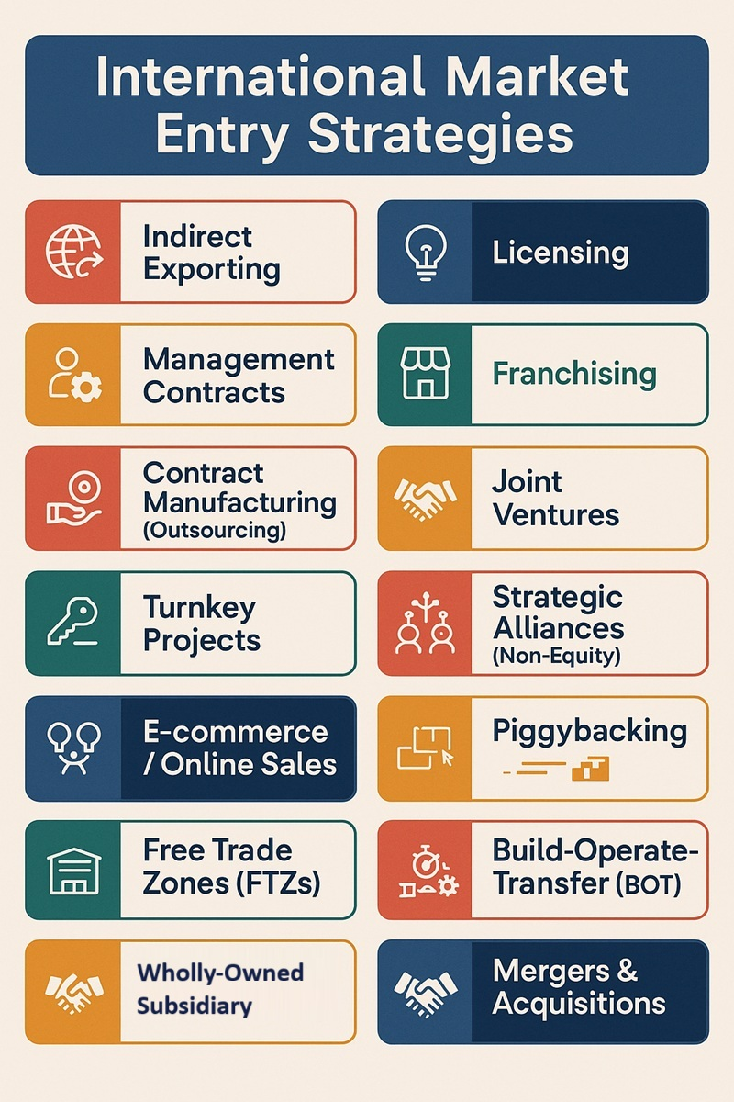
Entry Strategy
Entry strategy refers to the method or approach used by a company to enter and establish its business operations in a foreign market. When companies expand internationally, they must carefully choose how they will introduce their products or services in another country. The choice of entry strategy depends on several factors such as investment cost, level of risk, market potential, government regulations, and the company’s long-term business objectives.
Selecting the right entry strategy is important because it determines how much control a company has over its operations, the amount of resources required, and the level of risk involved in entering the foreign market. Companies may choose simple strategies such as exporting or more complex strategies such as joint ventures and wholly owned subsidiaries depending on their goals and capabilities.
Example: A clothing company from India may first enter the European market by exporting its products through local distributors before establishing its own stores in those countries

Slide 7
Types of Entry Strategies
Companies use different entry strategies to enter foreign markets depending on their investment capacity, risk tolerance, and long-term business goals. Each strategy provides a different level of control, cost, and risk for the company. Selecting the appropriate entry strategy helps businesses expand internationally while minimizing potential risks.
The most common types of entry strategies used in international business are:
Exporting Exporting is the process of selling products manufactured in one country to customers in another country. It is the simplest and least risky method of entering foreign markets because companies do not need to establish production facilities abroad. Example: Indian textile companies export garments to the United States and Europe.
Licensing Licensing is an agreement in which a company allows a foreign firm to use its technology, brand name, patent, or trademark in exchange for royalties or fees. Example: A pharmaceutical company may license its medicine formula to another company in a foreign country.
Franchising Franchising is a business arrangement where a company allows a foreign partner to use its brand name, business model, and operational methods to run a business. Example: McDonald's expands internationally through franchising.
Joint Venture A joint venture is a partnership between two or more companies from different countries that share investment, risks, and profits to operate a business together. Example: Starbucks partnered with Tata Group to operate Starbucks stores in India.
Wholly Owned Subsidiary A wholly owned subsidiary is when a company establishes or acquires a business in another country and owns 100% of its operations. This provides full control but requires significant investment. Example: Toyota establishing manufacturing plants in foreign countries.

Slide 8

Exporting
Exporting is one of the most common and simplest methods used by companies to enter international markets. It refers to the process of selling goods or services produced in one country to customers located in another country. In this method, companies manufacture their products in the home country and then transport them to foreign markets for sale. Exporting allows businesses to expand their market reach without making large investments in foreign production facilities.
Exporting is considered a low-risk entry strategy because companies do not need to establish manufacturing plants or offices in the foreign country. Instead, they can sell their products through local distributors, agents, or international trade partners. However, companies must still deal with transportation costs, tariffs, and international trade regulations when exporting products.
Example: Indian textile companies export garments and fabrics to countries such as the United States, the United Kingdom, and Germany. This allows them to reach international customers while continuing production in India.

Slide 9
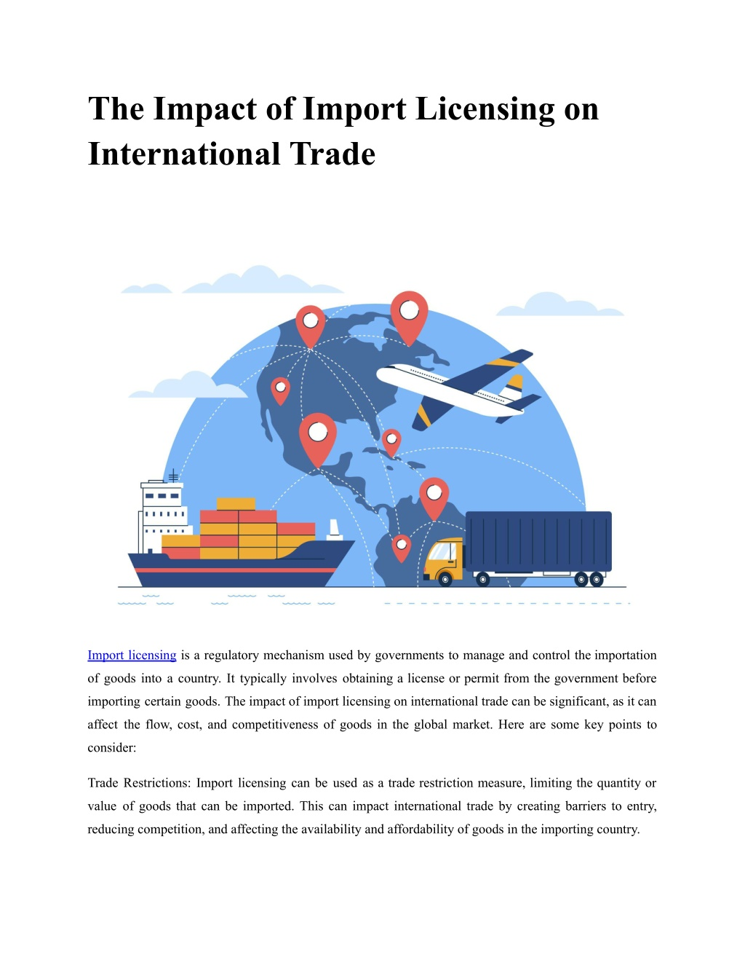
Licensing
Licensing is an entry strategy in international business where a company (known as the licensor) allows a foreign company (known as the licensee) to use its intellectual property such as technology, patents, trademarks, brand name, or production processes for a specific period of time. In return, the licensee pays a fee or royalty to the licensor. This method allows companies to expand into foreign markets without making large investments in production facilities or operations.
Licensing is often used when a company wants to enter a foreign market quickly while reducing financial risks. It also helps companies take advantage of local market knowledge and distribution networks provided by the licensee. However, one disadvantage of licensing is that the licensor has less control over the production and marketing of its products in the foreign market.
Example: A pharmaceutical company may license its drug formula to a foreign company so that the foreign company can manufacture and sell the medicine in its own country while paying royalties to the original company.

Slide 10

Franchising
Franchising is an entry strategy in international business where a company (known as the franchisor) allows a foreign partner (known as the franchisee) to use its brand name, business model, products, and operational methods to run a business. In return, the franchisee pays fees or royalties to the franchisor. This method is commonly used by companies in the service industry such as restaurants, hotels, and retail businesses.
Franchising helps companies expand internationally with lower investment and reduced risk because the franchisee is responsible for managing the local business operations. The franchisor provides training, marketing support, and business guidelines to ensure that the business maintains the same quality and standards worldwide. However, franchising requires strict control to maintain brand reputation and service quality.
Example: McDonald’s expands its restaurants around the world through franchising. Local entrepreneurs operate McDonald’s outlets using the company’s brand name, menu, and business system while paying franchise fees to the company.

Slide 11
Wholly Owned Subsidiary
A wholly owned subsidiary is an entry strategy in international business where a company owns 100% of the business operations in a foreign country. In this method, the parent company has complete ownership and full control over production, marketing, management, and other business activities in the foreign market. Companies usually establish wholly owned subsidiaries either by setting up a new business facility in another country or by acquiring an existing foreign company.
This strategy provides companies with greater control over their international operations and helps maintain product quality, brand reputation, and management decisions. However, it requires a large amount of investment and involves higher risks because the company must handle all operational responsibilities and financial commitments in the foreign market.
Example: Automobile companies such as Toyota establish wholly owned manufacturing plants in other countries to produce and sell vehicles while maintaining full control over their operations and quality standards.

Slide 12
Joint Venture
A joint venture is an entry strategy in international business where two or more companies from different countries agree to establish a new business entity and share ownership, investment, risks, and profits. In this arrangement, the partner companies combine their resources, technology, and expertise to operate a business in a foreign market. Joint ventures are often used when companies want to enter a new market but prefer to share risks and responsibilities with a local partner.
Joint ventures are beneficial because the foreign partner usually has better knowledge of the local market, culture, government regulations, and business environment. This helps the international company operate more effectively in the foreign country. However, joint ventures may also face challenges such as conflicts between partners, differences in management styles, and disagreements over decision-making.
Example: Starbucks entered the Indian market through a joint venture with the Tata Group, where both companies shared resources and worked together to expand the Starbucks brand in India.

Slide 13

Strategic Alliances
A strategic alliance is a cooperative agreement between two or more companies from different countries that work together to achieve common business objectives while remaining independent organizations. In this arrangement, the companies share resources such as technology, knowledge, research, marketing networks, or distribution systems to strengthen their competitive position in the international market.
Strategic alliances are often formed when companies want to enter new markets, develop new technologies, or reduce business risks without making large financial investments. By collaborating with other companies, organizations can benefit from shared expertise and improve their ability to compete in global markets. However, successful strategic alliances require strong coordination, trust, and clear communication between the partner companies.
Example: Technology companies often form strategic alliances to develop new products. For instance, automobile companies may partner with technology firms to develop advanced electric vehicles and autonomous driving systems.

Slide 14
Advantages of Strategic Alliances
Sharing Resources and Technology Strategic alliances allow companies to share important resources such as technology, knowledge, and expertise. This helps businesses improve their capabilities and develop better products or services. Example: Automobile companies may partner with technology firms to develop electric vehicles.
Reducing Business Risks When companies collaborate through alliances, they share the risks associated with entering new markets or developing new technologies. This reduces the financial burden on each partner. Example: A company entering a new country may partner with a local firm to reduce market risks.
Access to New Markets Strategic alliances help companies enter foreign markets more easily because local partners have knowledge of customer preferences, regulations, and distribution networks. Example: Starbucks partnered with Tata Group to enter the Indian market.
Improving Innovation and Product Development Collaboration between companies encourages innovation because each partner contributes different skills and ideas. This helps develop advanced products and services. Example: Technology companies collaborate to develop new software and hardware products.
Cost Sharing and Efficiency Strategic alliances allow companies to share costs related to research, development, production, and marketing, which improves operational efficiency. Example: Pharmaceutical companies often collaborate to share research and development costs for new medicines.

Slide 15
Organization of International Business
The organization of international business refers to the way multinational companies structure and manage their operations across different countries. When companies expand into international markets, they need an effective organizational structure to coordinate activities such as production, marketing, finance, and human resources across various regions. A well-designed structure helps organizations manage their global operations efficiently and ensures smooth communication between headquarters and foreign subsidiaries.
An appropriate organizational structure allows multinational companies to make better decisions, allocate resources effectively, and respond quickly to changes in global markets. It also helps companies manage cultural differences, government regulations, and market conditions in different countries. By organizing international operations properly, businesses can improve coordination, increase efficiency, and maintain consistency in their products and services worldwide.
Example: A multinational automobile company may organize its global operations into regional divisions such as Asia-Pacific, Europe, and North America to manage production, marketing, and sales activities more effectively in each region.

Slide 16
Importance of Organizational Structure
Improves Coordination and Communication A clear organizational structure helps coordinate activities between different departments and ensures smooth communication among employees and management across various locations. Example: In multinational companies, headquarters communicate with regional offices to manage global operations effectively.
Clarifies Roles and Responsibilities Organizational structure defines the duties, authority, and responsibilities of employees, which helps avoid confusion and improves work efficiency. Example: In a multinational company, managers, supervisors, and employees have clearly defined roles in different departments.
Supports Effective Decision-Making A well-designed structure allows managers to make quick and effective decisions because responsibilities and reporting relationships are clearly defined. Example: Regional managers may make decisions about marketing strategies in their specific markets.
Helps Manage Global Operations Efficiently International businesses operate in multiple countries, and a structured organization helps manage activities such as production, distribution, and marketing across different regions. Example: A company may establish regional divisions for Asia, Europe, and North America.
Improves Organizational Efficiency and Productivity When tasks and responsibilities are properly organized, employees can perform their work more efficiently, which improves overall productivity. Example: Global companies organize teams according to product lines or regions to improve performance.

Slide 17
Types of Organizational Structure
Functional Structure – Based on functions like Marketing, Finance, HR
Divisional Structure – Based on products, services, or regions
Matrix Structure – Combination of functional and divisional (dual reporting)
Line Structure – Simple hierarchy with clear chain of command
Line & Staff Structure – Line managers + expert advisors
Flat Structure – Fewer levels, more employee involvement
Network Structure – Core company + outsourced functions

Slide 18
Case Study: Starbucks’ International Expansion Strategy
Starbucks, one of the world’s leading coffeehouse chains, has successfully expanded its business into many international markets. When Starbucks decided to enter the Indian market, the company realized that it needed a strong local partner who understood the country’s culture, consumer preferences, and business environment. Instead of entering the market alone, Starbucks formed a strategic alliance with Tata Group, one of India’s largest and most respected business conglomerates.
The partnership was established through a joint venture called Tata Starbucks Private Limited. Tata Group provided knowledge about the Indian market, local supply chains, and regulatory environment, while Starbucks contributed its global brand, coffee expertise, and international business strategy. This collaboration allowed Starbucks to expand its operations quickly and efficiently in India.
Through this strategic alliance, Starbucks was able to adapt its products to suit Indian customers while maintaining its global brand identity. The company introduced menu items that matched local tastes and used Tata’s expertise to expand its store network across major Indian cities.
This case highlights how strategic alliances and joint ventures can help multinational companies enter foreign markets successfully. By partnering with a local company, Starbucks reduced risks, gained market knowledge, and strengthened its international business strategy.

Slide 19
Discussion question
Why did Starbucks choose a strategic alliance with Tata Group to enter the Indian market?
What advantages did Starbucks gain by forming a joint venture instead of entering the market independently?
How do strategic alliances help multinational companies expand into foreign markets?
What challenges might companies face when forming international partnerships?

Slide 20


